Slide 1

Recent Advances in
Particle Swarm Optimization
（粒子群优化算法）
Yong Wang
School of Automation
Central South University
ywang@csu.edu.cn
https://intleo.csu.edu.cn/

Slide 2
Outline of Talk
The Origin of Particle Swarm Optimization
The Classic Particle Swarm Optimization
The State-of-the-Art Particle Swarm Optimization
-<number>-

Slide 3
Outline of Talk
The Origin of Particle Swarm Optimization
The Classic Particle Swarm Optimization
The State-of-the-Art Particle Swarm Optimization
-<number>-

Slide 4
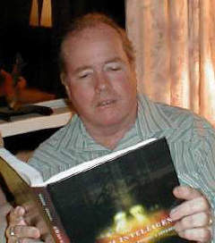

The Origin of Particle Swarm Optimization
Particle Swarm Optimization (PSO) was invented by James Kennedy and Russ Eberhart in 1995
Originally, PSO is proposed for optimization of continuous nonlinear functions
J. Kennedy
R. Eberhart
A social psychologist
An electrical engineer
J. Kennedy and R. C. Eberhart, “Particle swarm optimization,” in Proc. IEEE Int. Conf. Neural Networks, 1995, pp. 1942-1948.
-<number>-

Slide 5


The Origin of Particle Swarm Optimization
PSO has roots in two main component methodologies
  Artificial life
    Bird flocking（鸟群）, fish schooling（鱼群）, and swarming theory（群理论） (in particular)
  Evolutionary algorithms
    Genetic algorithm and evolutionary programming (in particular)
-<number>-

Slide 6
Outline of Talk
The Origin of Particle Swarm Optimization
The Classic Particle Swarm Optimization
The State-of-the-Art Particle Swarm Optimization
-<number>-

Slide 7
The Classic Particle Swarm Optimization
The velocity（速度） update equation of the original PSO
A generalization（一个推广）
v_{i,j}=v_{i,j}+2*rand*(pbest_{i,j}-present_{i,j})+2*rand*(gbest_{j}-present_{i,j})
the global version
v_{i,j}=v_{i,j}+2*rand*(pbest_{i,j}-present_{i,j})+2*rand*(lbest_{j}-present_{i,j})
the local version
t is the generation number（代数）
i=1,…N, j=1,..,D
c₁ and c₂ are the acceleration constants（加速常量）
r₁ and r₂ are uniformly distributed random numbers（均匀分布随机数） in the range [0,1]
-<number>-

Slide 8
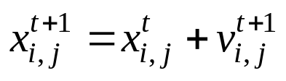
The Classic Particle Swarm Optimization
The movement equation（运动方程） of the classic PSO
velocity update equation（速度更新）
position update equation（位置更新）
cognition part
social part
Remark: in PSO, each variable is updated independently（独立地）
Kennedy, J. The particle swarm: social adaptation of knowledge, Proc. IEEE International Conference on Evolutionary Computation (Indianapolis, Indiana), IEEE Service Center, Piscataway, NJ, pp. 303-308, 1997.
-<number>-

Slide 9
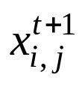


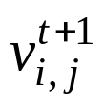

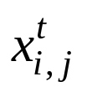
The Classic Particle Swarm Optimization
The main principle of the movement equation
the global version
-<number>-

Slide 10
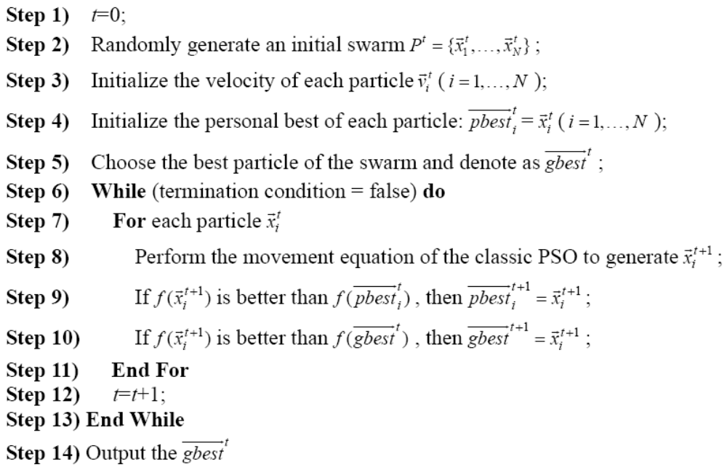
The Classic Particle Swarm Optimization
The framework of the classic PSO
-<number>-

Slide 11







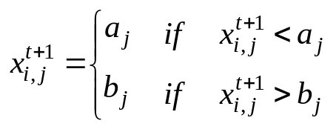
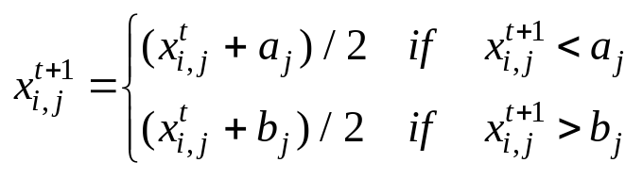
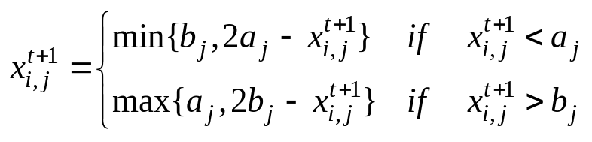
The Classic Particle Swarm Optimization
Some issues
  should be limited by some value
    It keeps the computer from overflowing
    It simulates the incremental（增量式） changes of human learning and attitude change
    It determines the granularity of search of the problem space
  If is out of the search region [a_{j},b_{j}], a repair（修补） operator should be applied
&
-<number>-

Slide 12


The Classic Particle Swarm Optimization
There are three main parameters in the classic PSO
    If is toot high, particles might fly past good solutions
    If is too small, particles might not explore sufficiently beyond locally good regions
    Usually,
  c₁ and c₂
    Low values allow particles to roam far from the target region before being tugged back
    High values result in abrupt movement toward the target region
    Usually, c₁=c₂=2
-<number>-

Slide 13
The Classic Particle Swarm Optimization
The similarity with other evolutionary algorithms (EAs)
  It is highly dependent on stochastic processes
  The adjustment toward pbest and gbest by PSO is conceptually similar to the crossover operator of genetic algorithm
  It uses the concept of fitness
-<number>-

Slide 14
The Classic Particle Swarm Optimization
The difference with other evolutionary algorithms (EAs)
  In PSO, each particle is flying potential solution through the hyperspace, accelerating toward better solutions
  Other EAs operate directly on potential solutions which are represented as locations in the hyperspace
  PSO has memory and does not have the selection operator
-<number>-

Slide 15


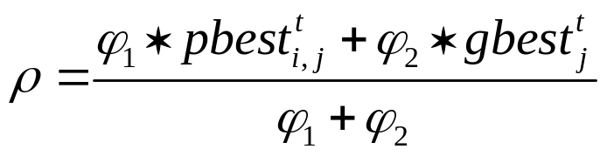








An Analysis of PSO
Let
胡旺, 李志蜀.一种更简化而高效的粒子群优化算法. 软件学报, 2007, 18(4): 861-868.
-<number>-

Slide 16
Outline of Talk
The Origin of Particle Swarm Optimization
The Classic Particle Swarm Optimization
The State-of-the-Art（先进的） Particle Swarm Optimization
-<number>-

Slide 17
Current Research Directions of PSO
Due to its simplicity and effectiveness, PSO has become a popular optimizer
Much effort has been made to improve the performance of PSO
  Adapting the control parameters
    such as c₁ and c₂
  Designing population topology (Velocity update equation)
    the way particle communication or share information with each other
    static topology or dynamic topology
  Hybrid PSO with auxiliary operations
  Self-learning and adaptive strategies
-<number>-

Slide 18
A Modified PSO (1/2)
The classic velocity update equation
  local search
  global search
①
②
③
  If the above equation only has the first term, the particles will keep on “flying” at the current speed in the same directions until they hit the boundary
  If the above equation does not have the first term, the search range statistically shrinks through the generations, and the swarm stagnates due to the lack of momentum（缺乏动力）
  By adding the first term, the particles have a tendency to expand the search space, having the ability to explore the new area
-<number>-

Slide 19

A Modified PSO (2/2)
How to balance the global and local search in PSO
  A inertia weight is added into the generalized velocity
  A large inertia weight facilitates the global search
  A small inertia weight facilitates the local search
How to set the parameter value of
  Medium setting, such as 0.9< <1.2
  Linearly decreasing setting, such as starts at 0.9 and ends at 0.4
Y. Shi and R. C. Eberhart, “A modified particle swarm optimizer,” in Proc. IEEE Int. Conf. Evolutionary Computation, Anchorage, AK, May 1998, pp. 69-73.
-<number>-

Slide 20
A Generalized Model (1/3)
Explosion in the classic PSO
  Due to the random weighting of the control parameters, the velocities and position of the particles might careen toward infinity.
  The explosion can be contained by making using of and the inertia weight
  However, it is still an open issue to set the value of
-<number>-

Slide 21
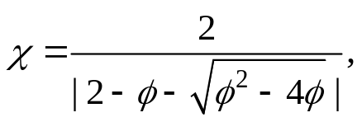





A Generalized Model (2/3)
Clerc and Kennedy proposed the use of a constriction coefficient by analyzing a particle’s trajectory（轨迹）
The generalized model（推广模型）
where
and
constriction coefficient
（限制系数）
a special case
In general,
and
0.729
1.49445
1.49445
Clerc M, Kennedy J. The particle swarm-explosion, stability, and convergence in a multidimensional complex space. IEEE Transactions on Evolutionary Computation, vol. 6, no. 1, pp. 58-73, 2002.
-<number>-

Slide 22

A Generalized Model (3/3)
The advantages of the generalized model
  The explosion（爆炸） can be prevented
  It makes the limit unnecessary
  It can guarantee convergence on local optima
However, the performance of the generalized model can be significantly improved by limiting to
R. C. Eberhart and Y. Shi, “Comparing inertia weights and constriction factors in particle swarm optimization,” in Proceeding of 2000 Congress on Evolutionary Computation, San Diego, CA, July 2000, pp. 84-88.
-<number>-

Slide 23
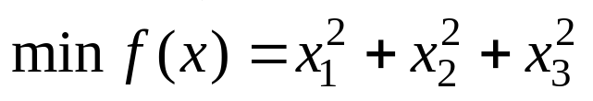

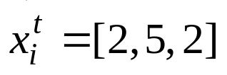
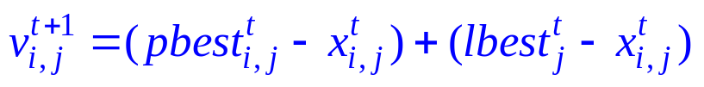
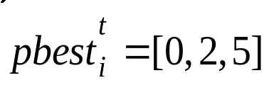
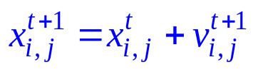




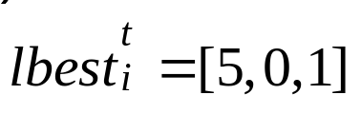
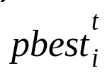
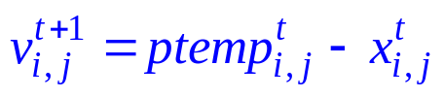
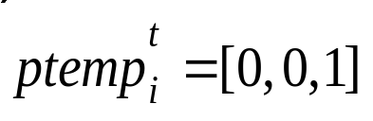





Orthogonal Learning PSO (1/6)
Motivation
  In traditional PSO, each particle updates its velocity by linearly adding its personal best and its neighborhood’s best
  The above learning strategy may cause oscillation（抖动）
  The above learning strategy may also cause inefficiency（不高效）
is worse than
﹤
①
﹤
②
①
②
is better than and
-<number>-

Slide 24
Orthogonal Learning PSO (2/6)
Orthogonal learning (OL，正交学习) strategy
  The OL strategy is designed to discover, preserve, and utilize useful information from the personal best and the neighborhood’s best
  The OL strategy can guide particles to fly in better directions by constructing a promising and efficient learning exemplar
  The OL strategy is implemented via orthogonal experimental design (OED)
Z.-H. Zhan, J. Zhang, Y. Li, and H. S.-H. Chung, “Orthogonal learning particle swarm optimization,” IEEE Trans. Evol. Comput., vol. 15, no. 6, pp. 832-847, 2011.
-<number>-

Slide 25
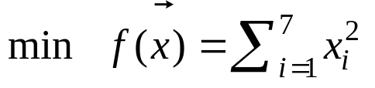
Orthogonal Learning PSO (3/6)
Orthogonal experimental design (OED，正交试验设计)
An example:
 | Factors (K)
 | x₁ | x₂ | x₃ | x₄ | x₅ | x₆ | x₇
Levels (Q) | 0.0 | 0.0 | 0.0 | 0.0 | 0.0 | 0.0 | 0.0
 | 1.0 | 1.0 | 1.0 | 1.0 | 1.0 | 1.0 | 1.0
A level combination:
1.0 | 0.0 | 0.0 | 0.0 | 1.0 | 1.0 | 0.0
Remark: a level combination is called an experiment, and therefore, the number of all the experiments (i.e., complete factorial experiment) is Q^{K}
the main aim of OED is to choose several representative combinations, i.e., fractional factorial experiments
-<number>-

Slide 26
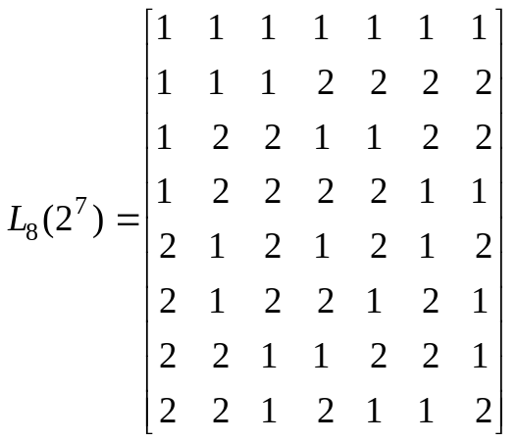

Orthogonal Learning PSO (4/6)
Orthogonal experimental design (OED): two major tools
  Orthogonal array（正交矩阵）: an orthogonal array for K factors with Q levels and M combinations is often denoted by L_{M}(Q^{N}).
Remark 1: this paper uses orthogonal array with two levels
a level combination
Remark 2: In orthogonal array with two levels,
a level
a factor
    Remark 3: the orthogonality of an orthogonal array means that:
      each level of the factor occurs the same number of times in each column
      each possible level combination of any two given factors occurs the same number of times in the array.
-<number>-

Slide 27
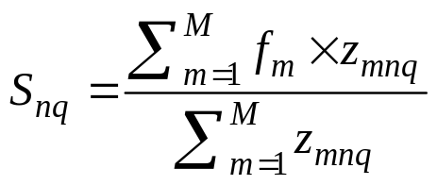
Orthogonal Learning PSO (5/6)
Orthogonal experimental design (OED): two major tools
  Factor analysis（因子分析）
x₁ | x₂ | x₃ | x₄ | x₅ | x₆ | x₇
1.0 | 1.0 | 1.0 | 0.0 | 1.0 | 1.0 | 0.0
0.0 | 0.0 | 0.0 | 1.0 | 0.0 | 0.0 | 1.0
Individual 1
Individual 2
Level 1
Level 2
Combinations | x₁ | x₂ | x₃ | x₄ | x₅ | x₆ | x₇ | f
1 | 1.0 | 1.0 | 1.0 | 0.0 | 1.0 | 1.0 | 0.0 | 5
2 | 1.0 | 1.0 | 1.0 | 1.0 | 0.0 | 0.0 | 1.0 | 5
3 | 1.0 | 0.0 | 0.0 | 0.0 | 1.0 | 0.0 | 1.0 | 3
4 | 1.0 | 0.0 | 0.0 | 1.0 | 0.0 | 1.0 | 0.0 | 3
5 | 0.0 | 1.0 | 0.0 | 0.0 | 0.0 | 1.0 | 1.0 | 3
6 | 0.0 | 1.0 | 0.0 | 1.0 | 1.0 | 0.0 | 0.0 | 3
7 | 0.0 | 0.0 | 1.0 | 0.0 | 0.0 | 0.0 | 0.0 | 1
8 | 0.0 | 0.0 | 1.0 | 1.0 | 1.0 | 1.0 | 1.0 | 5
 | Factor Analysis
S_{n1} | 4 | 4 | 4 | 3 | 4 | 4 | 3
S_{n2} | 3 | 3 | 3 | 4 | 3 | 3 | 4
Better level | 2 | 2 | 2 | 1 | 2 | 2 | 1
The better value of each variable | 0.0 | 0.0 | 0.0 | 0.0 | 0.0 | 0.0 | 0.0 | 0
the mth combination
the nth factor
the qth level
“0” or “1”
-<number>-

Slide 28
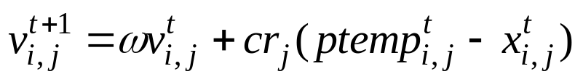
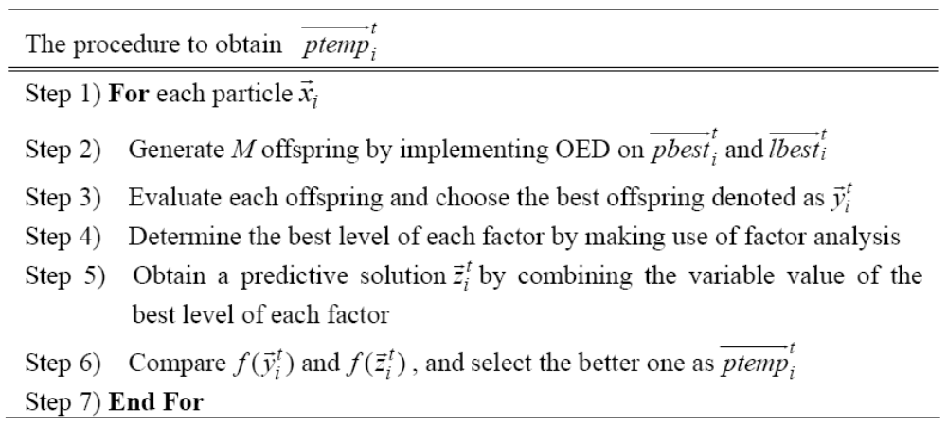


Orthogonal Learning PSO (6/6)
The implementation of OL strategy
learning exemplar
（学习榜样）
Remark: will be used as the exemplar for a certain number of generations until it cannot lead to a better position
-<number>-

Slide 29
Thank you very much for your attention!

